Slide 1
Predicting Customer Churn

Slide 2
Minimizing Customer Churn
Given the customer data from SyriaTel, I built a model that can predict whether or not a customer will churn in the near future.
Uses for predictions:
Attempt to retain customers
Focus promotions on customers predicted to churn
Better predict future revenue

Slide 3
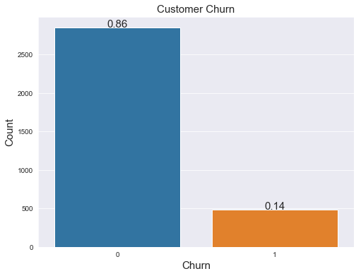
Taking a Look at the Data

Slide 4
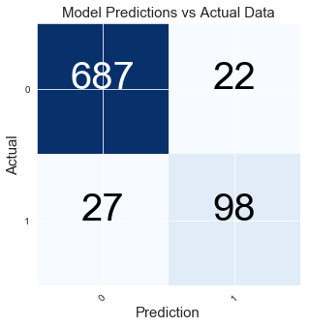
Fitting a Model to the Data
Model optimized to minimize false negatives (customers that will churn but the model fails to identify them)
The model’s overall accuracy is 94%
The model will catch 78% of the customers who will actually churn
Out of the customers the model predicted will churn, 82% of them will actually churn
True Negative
False Positive
False Negative
True Positive

Slide 5
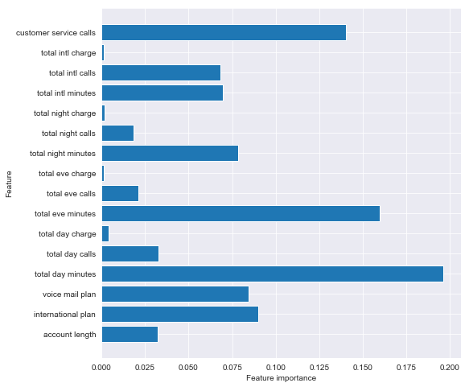
Fitting a Model to the Data
Most important features to predict churn for the model:
Total Day Minutes
Total Evening Minutes
Customer Service Calls
International Plan
Voice Mail Plan

Slide 6
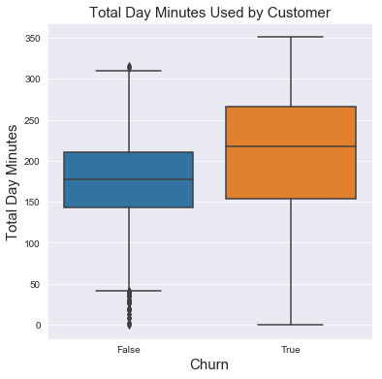
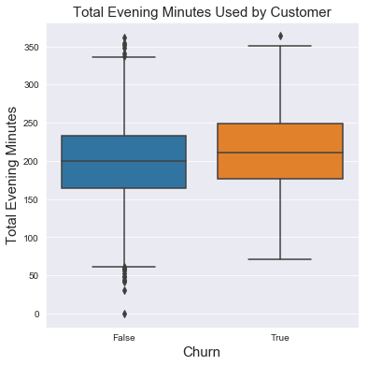
Visualizing Data

Slide 7
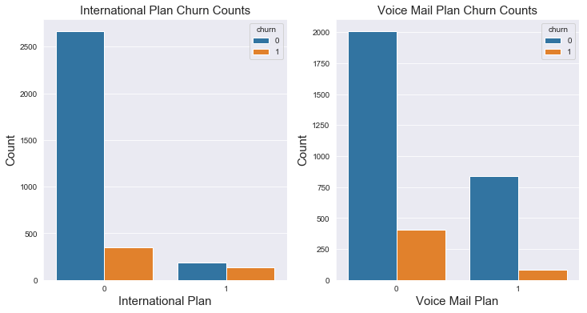
Visualizing Data

Slide 8
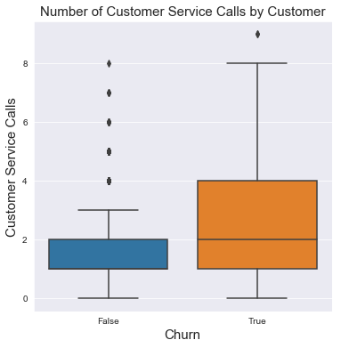
Visualizing Data
Customers that churn will, on average, have 1-2 more customer service calls than customers that will not churn

Slide 9
Future Work
Some things to take into consideration:
The model is only as good as the data given. As more data is gathered, it can be used to further improve upon the model
The most important features are unique to each model. Are there other features where we could see predictable patterns?

Slide 10
Thank you

